Slide 1




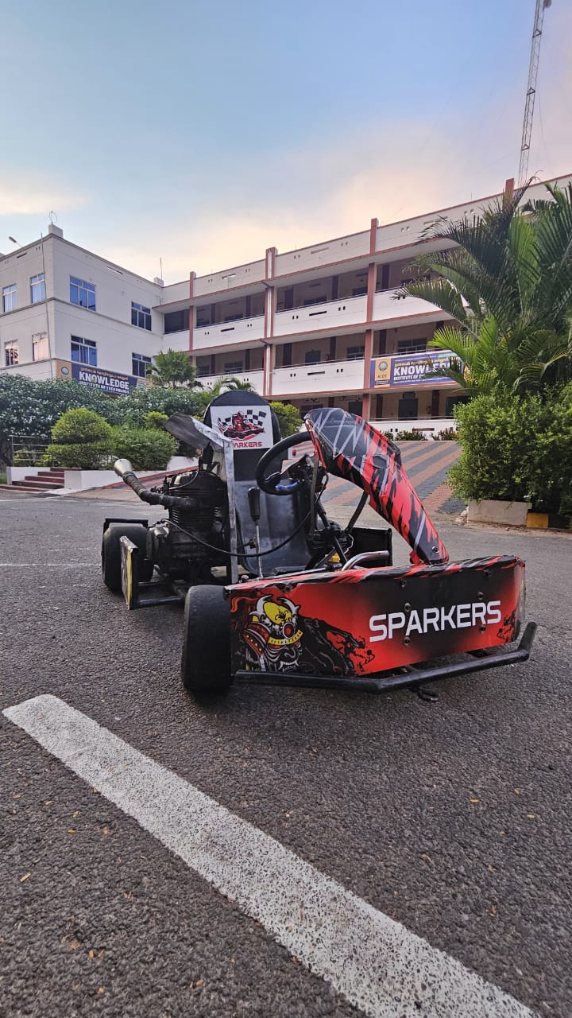
GO-KART PRESENTATION
"Speed, Challenge, Triumph!"
TEAM NAME : SPARKERS
TEAM VIN NO : ASI-TEAM-00084
COLLEGE NAME : KNOWLEDGE INSTITUTE OF TECHNOLOGY
ENGINE CATEGORY : 160cc
FUEL SYSTEM : CARBURETOR
Notes:
Vehicle 3-D image

Slide 2
Team Composition And Allocation
SI. NO | NAME | DESIGNATION
1 | HARISH A | CAPTAIN
2 | ANISH C | VICE CAPTAIN
3 | PRITHIV RAJ V | DRIVER
4 | KARTHICK S S | DRIVER
5 | SAKTHIVEL V (HEAD) | CHASIS AND FABRICATION
6 | VERARAGAVAN A | CHASIS AND FABRICATION
7 | GOKUL K | CHASIS AND FABRICATION
8 | SANTHOSH S | CHASIS AND FABRICATION
9 | SRI NATH | CHASIS AND FABRICATION
10 | LINGESHWARAN K M (HEAD) | POWER TRAIN
11 | VIJAY R | POWER TRAIN
12 | PREM KUMAR G | POWER TRAIN
13 | RAJENDRA HARI PRASATH | POWER TRAIN
14 | SANTHOSH G | POWER TRAIN
15 | SURENDHAR G (HEAD) | STEERING
16 | VIVIN B K | STEERING
SI. NO | NAME | DESIGNATION
17 | MAHESH RAJ P | STEERING
18 | BALAJI | STEERING
19 | KAVIN M | STEERING
20 | SABARI M | STEERING
21 | KARTHI V S (HEAD) | BRAKE
22 | PRAKASH K | BRAKE
23 | SHARAN G | BRAKE
24 | JAYAPRASATH | BRAKE
25 | SANTHOSH G | BRAKE
26 | DINESH KARTHICK | BRAKE
27 | GURU PRASANNA V [HEAD] | DESIGN
28 | BOOPESH K | DESIGN
29 | MANORENJITH S | DESIGN
30 | DEEPAKSANJEI S | DESIGN
31 | PALANIYAPPAN A | DESIGN

Slide 3

Important Rules
Safety Jackets: Team members must wear orange jackets with team name and vehicle number
(1-inch letters) to access the track during dynamic events.
Technical Inspection: Vehicles must pass inspection, including checks on electrical, tractive system, engine, brakes, and driver safety.
Battery Mounting: Batteries must be securely mounted away from the driver’s seat or cockpit.
Night Visibility: Vehicles must have tape or radium lights on exposed parts during night endurance races.
Tilt Test: Vehicles must be free of oil leaks when tilted at 45-degree angles.
Reverse Light and Alarm: Vehicles must have a reverse light and alarm for reverse gear.
Fire Extinguishers: Teams must have two fire extinguishers—one in the vehicle and one in the pit.
Vehicle Size Compliance: Vehicles must comply with maximum size limits or be disqualified.

Slide 4
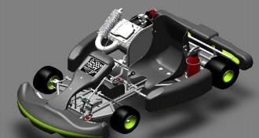
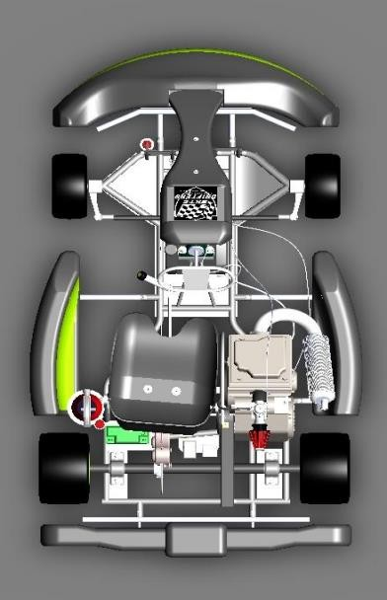
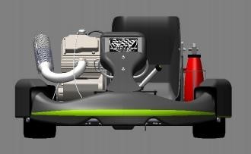
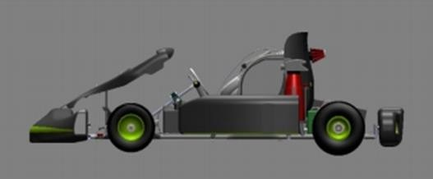
Technical Specifications And 3D View
TECHNICAL SPECIFICATION | RESPECTIVE VALUES
Overall Dimensions | Length : 68 inches Width : 45 inches
Track Width | Small : 49.5 inches Large : 49.75 inches
Wheel Base | 40 inches
Tire Size | Front : 10 X 4.7 X 5 in Rear : 11 X 7.1 X 5 in
Ground Clearance | 2 inches
Centre of Gravity | 19.32(from left side) 26.62(from front side)
Maximum Speed | 90 Km/hr
Maximum Acceleration | 5.88 m/s²
Weight | 170 Kg
Break Type | Hydraulic Disc
Fig. Isometric View
Fig. Front View
Fig. Isometric View
Fig. Side View

Slide 5

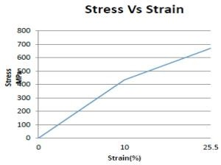
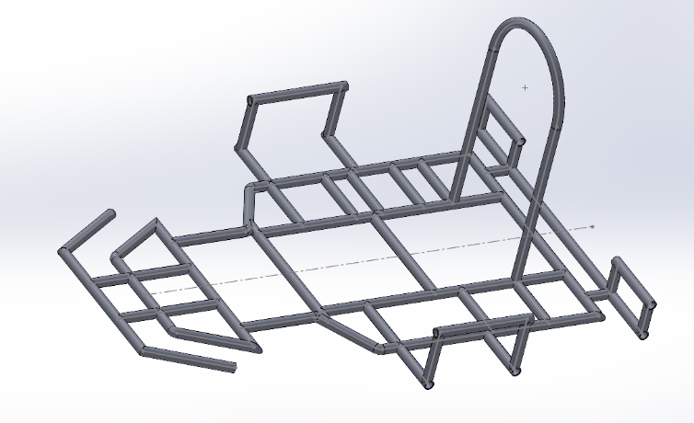
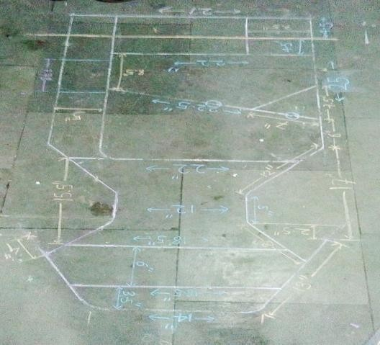
Design Methodology & Overall Performance Target
Properties | AISI 1018 | AISI 4130 | AISI 1026
Density (gm/cm²) | 7.8 | 7.8 | 7.8
Elasticity (GPa) | 210 | 210 | 210
Elongation % | 18-29 | 18-26 | 17-27
Strength to weight ratio (KNm/Kg) | 55-60 | 72-133 | 60-68
Thermal expansion (цm/mK) | 11.9 | 11.8 | 11.9
UTS (MPa) | 430-470 | 560-1040 | 470-530
Yield Strength (MPa) | 240-400 | 435-980 | 415-450
Fig. : Characteristic curve for AISI 4130
Roll Cage Mass | 22kg
Inner Diameter | 21.25 mm
Outer Diameter | 25.4 mm
Thickness | 2.075 mm

Slide 6
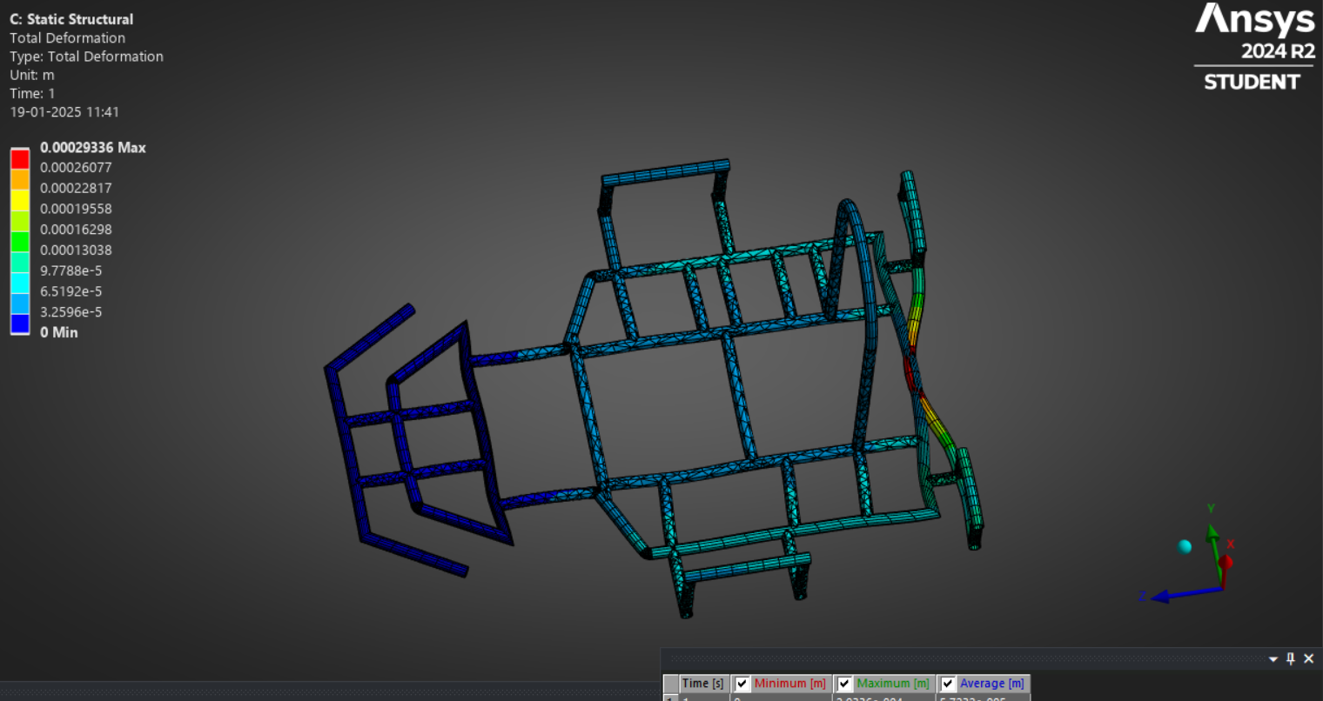
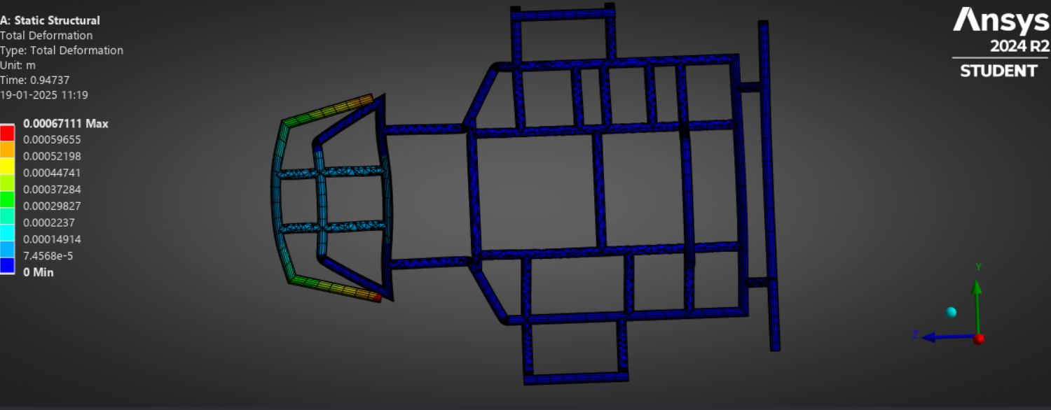
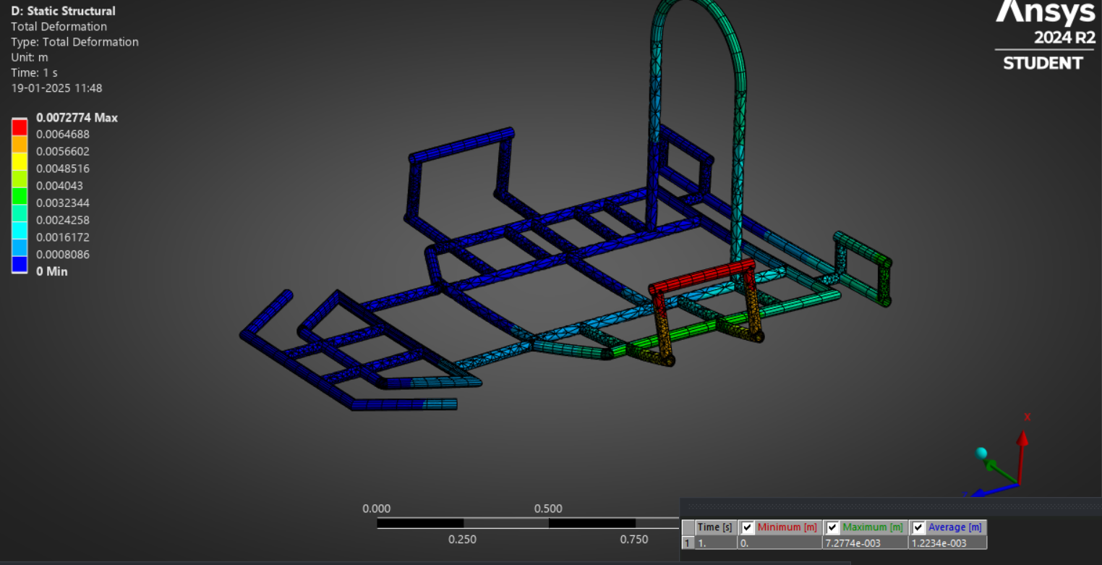
Chassis Analysis
Side impact
Front impact
PROPERTIES | FRONT | REAR | SIDE
FOS | 2.14 | 2. 6387 | 3 . 1331
PROPERTIES
Yield Strength (Mpa) | 450
Tensile Strength (MPa) | 670
MATERIAL | SPECS
TYPE | AISI 4130
DENSITY | 7.85 g/cc
Rear impact

Slide 7
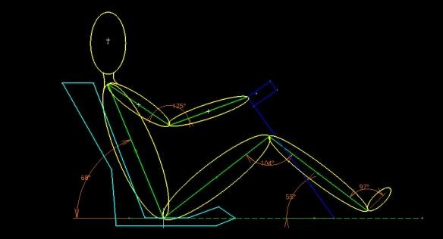
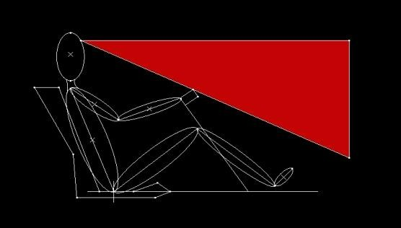
Ergonomics & Safety
Fig. Vision Cone
Fig. Driver Sitting Layout
Ergonomic considerations
Comfort for the User
Reducing the physical work load
Improving working postures
Making the handling of machine levers and controls easy
Increasing safety
Safety considerations
Kill switches( brake over travel, external access, drivers cockpit)
Fire extinguisher
Dot rated helmet
SFI rated driver’s suit
Gloves, shoes, neck support

Slide 8
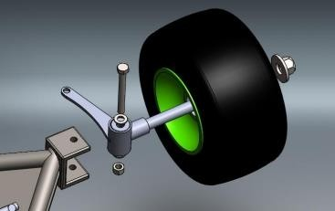
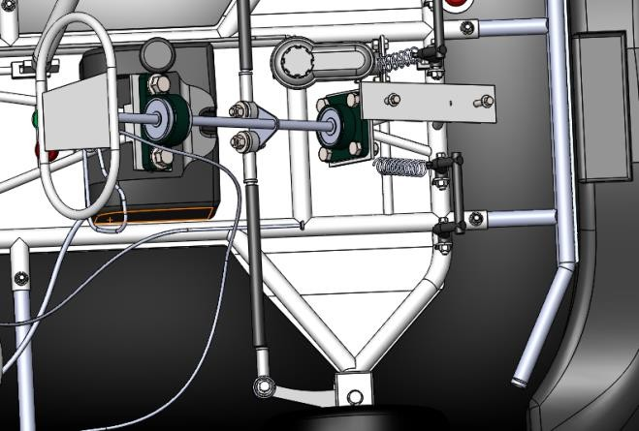
Steering System
Steering Parameter | Respective Values
Steering Wheel Radius | 5 inch
Mechanical Linkage Ratio | 10:1
Ackerman Percentage | 37.5
Ackerman Angle | Inside = 21 ° Outside =59 °
Turning Radius | 2.7m
Lock To Lock Distance | -230° to +230°
Fig. Front wheel assembly
Inside Angle | Outside Angle | Turning Radius
10° | 9.00° | 6.47 m
20° | 16.44° | 3.376 m
30° | 22.86° | 2.36 m
40° | 28.63° | 1.88 m
Fig. Steering System

Slide 9
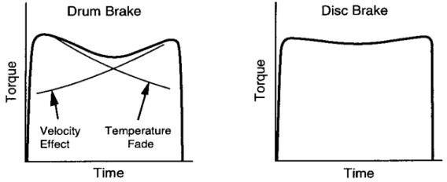
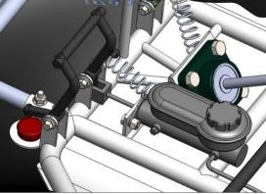
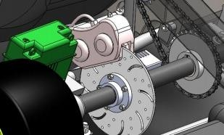
Breaking System
Speed | Stopping Distance | Stopping Time
50 Km/hr | 5.89 m | 1.41 sec
60 Km/hr | 23.57 m | 2.83 sec
70 Km/hr | 31.41 m | 3.26 sec
Parameters | Respective Values
Pedal Effort | 266.8 N
Leverage Ratio | 2:7
Master Cylinder Pressure | 4.13×10⁶ to 5.52×10⁶ N/m²
Caliper Force | 88.96 - 222.41 N
Clamping Force | 950 N
Disc Diameter | 200 mm
Disc Thickness | 4 mm
Brake Fluid Used | DOT 4
Height Of C.G. | 2 inches
Load Distribution | Front : 40% Rear: 60%
Fig. Disk vs. drum Graph
Fig : Braking system
Fig. Cad Model of Disc

Slide 10
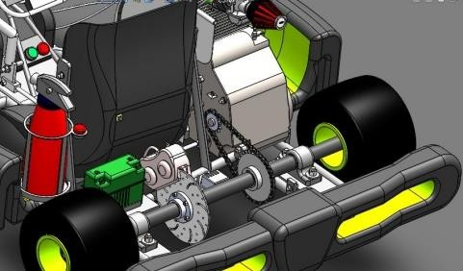
Engine And Transmission
SR. | Parameters | Respective Values
1. | Transmission Type | Manual Gear Box
2. | Final Drive Ratio | 1.76923
3. | Driving Sprocket | 13 teeth
4. | Driven Sprocket | 23 teeth
SR. | Parameters | Respective Values
1. | Engine | APACHE RTR 160 2V
2. | Maximum Power | 16.04 bhp @ 8700 rpm
3. | Maximum Torque | 13.85 Nm @ 7000 rpm
Gear | Gear Ratio | RPM At Axel | Torque In N-m | Power In KW
1 | 3 | 443 | 212.16 | 0.96
2 | 1.77 | 751 | 125.17 | 1.64
3 | 1.316 | 1010 | 93.06 | 2.22
4 | 1.045 | 1272 | 73.9 | 2.77
5 | 0.875 | 1519 | 61.8 | 3.31
Fig. Transmission System

Slide 11
Weights And BOM / Costing

Slide 12
DFMEA
COMPONENT | FUNCTION | POTENTIAL FAILURE MODE | POTENTIAL EFFECTS | S | POTENTIAL CAUSES | O | D | R.P.N. | ACTIONS TAKEN | S | O | D | R.P.N
BRAKES | Dissipate kinetic energy into heat | Leakage of fluid from brake line | Improper braking may cause accident | 7
 |  |  |  |  | Excessive fluid pressure | 5 | 4 | 140 | Use higher strength fluid lines | 7 | 4 | 2 | 84
 |  | Excessive pedal travel | Insufficient braking force | 6 | Low fluid in reservoir | 3 | 2 | 140 | Find out leakage and repair it | 6 | 4 | 2 | 48
 |  |  |  |  | Air trapped in system | 7 | 4 | 168 | Bleed the system and refill master cylinder | 6 | 3 | 4 | 72
KNUCKLE | Assist in steering | Variation in camber angle of both wheels | Tire may burst out | 9 | Improper positioning of knuckle | 8 | 9 | 648 | Set knuckle in proper position at same camber | 5 | 4 | 5 | 100
 |  | Excessive heating in knuckle assembly | Bearing failure leads to bursting out of tire | 9 | Proper placing of bearing | 8 | 9 | 648 | Proper bearing position | 5 | 4 | 5 | 100
PEDALS | For actuation of ACB | Constraints in pedal movement | Improper actuations in breaking & acceleration | 5 | Faulty placing at spring | 5 | 6 | 150 | Proper placing of spring | 8 | 3 | 2 | 48
 |  |  |  |  | Insufficient strength of spring | 5 | 7 | 175 | Select proper spring | 8 | 3 | 2 | 48
STEERING | To turn the vehicle/angular positioning of wheel | Steering hard to turn | Difficult to steer, may under steer | 4 | Low tire pressure | 9 | 1 | 36 | Proper sealing should be inspected | 6 | 4 | 1 | 24
 |  |  |  |  | Wheels are not properly aligned | 8 | 7 | 224 | Aligned wheel properly | 6 | 7 | 6 | 252
BATTERY | Provides electric energy | Discharge of battery | Failure of sub components runs on electric battery, brake light, starter | 7 | Reverse connection | 8 | 2 | 112 | Proper connections | 7 | 5 | 2 | 70
 |  |  |  |  | Excessive use | 8 | 1 | 56 | Keep running battery charging source | 7 | 1 | 2 | 14
TRANSMISSION | Transmit engine power to axle | Outward shaft of turn | Vehicle stop moving | 9 | Improper selection of sprocket wheel | 4 | 8 | 288 | Select proper sprocket wheel | 4 | 4 | 2 | 32
 |  |  |  |  | Inadequate lubrication | 6 | 2 | 108 | Provide lubrication in proper time period | 4 | 6 | 1 | 24

Slide 13
Design Validation
Sr no. | Parameter | Method of Checking | Design Value
1 | Wheel base | Distance from center of front wheel to center of rear wheel using measuring tape | 40 inch
2 | Wheel track | Minimum distance between center of both front wheels or rear wheels using measuring tape | 38 inch
3 | Weight | Weight of vehicle without driver and dry fuel tank measuring on weighing machine | 120 kg
4 | Turning radius | Radius of circle when steering wheel locked at full travel | 1.7 m
5 | Ackerman angles | Vehicle with steering wheel locked at full travel and angle between initial and final position. | Inside angle =40° Outside angle =28.63°
6 | Top speed | Max. rpm of engine*gear ratio*0.1047*radius of wheel | 90 km/hr
7 | Stopping distance | (top speed)^2 / (2*acceleration) | 30.79m @68km/hr
8 | Stopping time | (top speed)/ deceleration | 3.2 sec
9 | Deceleration | F= ma | 6.86 m/s²

Slide 14
GANTT Chart
Sr. No. | Task | Task Lead | Start | End | Duration (Days) | % Complete | Working Days
1. | Development | Harish A | 15/04 | 18/04 | 4 | 100 | 4
2. | Formation | Harish A | 19/04 | 26/04 | 7 | 100 | 7
3. | Registration | Harish A | 15/09 | 15/09 | 1 | 100 | 1
4. | Department Distribution | Harish A | 05/05 | 05/05 | 1 | 100 | 1
5. | Basic Understanding | Harish A | 01/06 | 05/06 | 5 | 100 | 5
6. | Market Survey | Anish C | 12/06 | 30/06 | 19 | 100 | 19
7. | Cost Report | Guru Prasanna V | 03/07 | 05/07 | 3 | 100 | 3
8. | Calculations | Boopesh K | 03/07 | 03/07 | 3 | 100 | 3
9. | Rulebook Analysis & Calculations | Guru Prasanna V | 10/07 | 14/07 | 5 | 100 | 5
10. | Chassis 3D Design | Guru Prasanna V | 15/07 | 24/07 | 10 | 100 | 10
11. | Chassis Analysis & Final Design | Boopesh K | 04/07 | 06/07 | 3 | 100 | 3
12. | Final Report | Guru Prasanna V | 10/08 | 24/08 | 15 | 100 | 15
13. | Material | Karthi V S | 04/09 | 11/09 | 7 | 100 | 7
14. | Manufacturing | Anish | 25/09 | 03/11 | 40 | 100 | 40
15. | Testing & Modification | Prithiv Raj V | 01/12 | 20/12 | 20 | 100 | 20
16. | Prerace |  | 22/12 | - | - | - | -

Slide 15
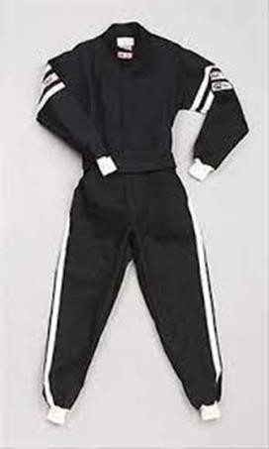
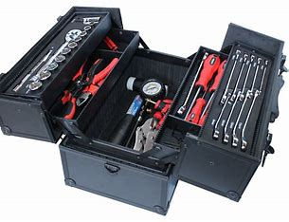
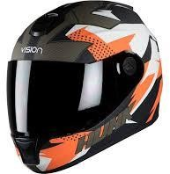
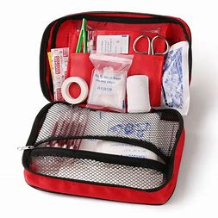
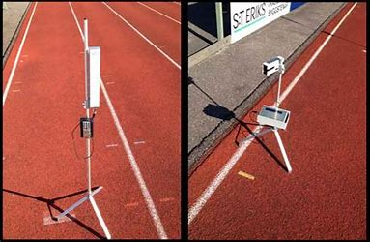
Safety Equipments
Safety
List of necessary equipment
Helmets
Seatbelts
Protective barriers
Track lighting
Timing system
Track cleaning equipment
Kart maintenance tools
Safety nets
Fire extinguishers
First aid kits
Danger
Turn
caution

Slide 16

Analysis
Strategy
Planning
Execution
Tracing
RACERS ARE NOT BORN THEY ARE MADE

